Slide 1
LEXICAL CAPTCHA BEAT-DOWN
STRUCTURED ATTACK APPROACH
Moshe Zioni twitter: @dalmoz_ email: zimoshe-gmail
Distribution and deriviation is allowed under the GNU Free Documentation License

Slide 2
INTRO – CAPTCHA PROMISE
CAPTCHAs are there to protect against misuse – flood, automated attacks
Minimizing impact of flood, DDoS, misuse and control.
/=-3r]]-3]] Humans, confirm! /132—[

Slide 3
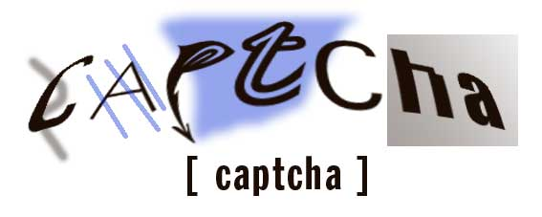
GOING LEXICAL
CAPTCHA is commonly known as this
It doesn’t have to be that way…

Slide 4
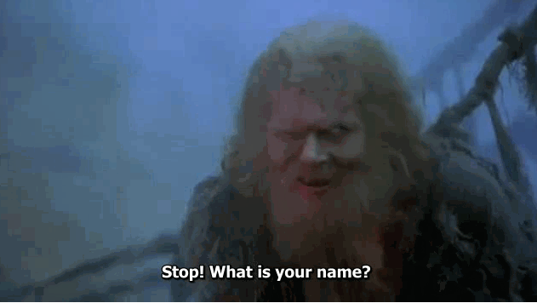
MEDIEVEL CAPTCHA

Slide 5
SO… LEXICAL ANALYSIS
BASICS – no rocket science needed, but a human mind is mandatory (synaptic connections enabled)
121 VS LEXICAL
Where to find them?

Slide 6
Basic terminology
TOKEN (!!!)
Lexeme
Key/Word/Keyword

Slide 7

Example

Slide 8
Stream to tokens
Identifier 1
Identifier 2

Slide 9
So, what?
Identifier 1
Identifier 2

Slide 10
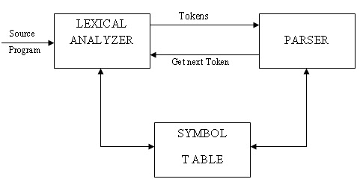
LEXER BUILDING

Slide 11
STEPS IN LEXER PROCESSING
Fetcher
Scan
Clean/Translate (?)
Head Selection
Head
Clean/Translate (?)
SOLUTION!

Slide 12
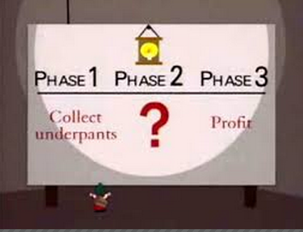
YEAH! Really… Now what?

Slide 13
Real world example
What word from "anointed, daringly, redeployment" begins with "r"?
Enter the largest number of 99, sixty three, 55 or 19:
"ketch" has how many letters?

Slide 14
Fetch
What word from "anointed, daringly, redeployment" begins with "r"?

Slide 15
Scan
What word from "anointed, daringly, redeployment" begins with "r"?
Tokenizing – 1, 2, 3, 4, 5
Distinct tokenization
Binary Tree – Boolean Logic

Slide 16
Process stream
What word from "anointed, daringly, redeployment" begins with "r"?
Always clean after scanning
Beware of pitfalls – you need to be sure of your scanning

Slide 17
Coverage
Why it’s important?
How to define coverage?
Brute force
Combinatorics (if given a number)

Slide 18
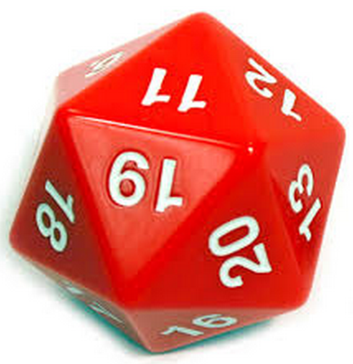
Efficiancy
In Lab is different then real world
Good and Bad
If no other options after scanning
- Always guess

Slide 19

Proof-of-Concept
Available at GitHub:
https://github.com/dalmoz/CAPLex

Slide 20
Thoughts on mitigations
?

Slide 21
Questions

Slide 22
Thank you
Moshe Zioni
Zimoshe-gmail
@dalmoz_

